Slide 1
Clustering
BITS Pilani
Pilani Campus
Prof .Vijayalakshmi Anand
BITS Pilani
<number>
Notes:
<number>

Slide 2
Outline
Application of clustering
Types of clustering
What is cluster analysis
Partition clustering
K-means clustering
Limitation of K-means Clustering
Hierarchical clustering
Density based clustering
<number>

Slide 3
What is Cluster Analysis?
Finding groups of objects such that the objects in a group will be similar (or related) to one another and different from (or unrelated to) the objects in other groups
Inter-cluster distances are maximized
Intra-cluster distances are minimized
<number>

Slide 4
Applications of Clustering
Marketing
Land use
Insurance
City-planning
<number>
Notes:
<number>

Slide 5
What is not Cluster Analysis?
Supervised classification
Have class label information
Simple segmentation
Dividing students into different registration groups alphabetically, by last name
Results of a query
Groupings are a result of an external specification
<number>

Slide 6
Quality: What Is Good Clustering?
A good clustering method will produce high quality clusters with
high intra-class similarity
low inter-class similarity
The quality of a clustering result depends on both the similarity measure used by the method and its implementation
The quality of a clustering method is also measured by its ability to discover some or all of the hidden patterns
<number>
Notes:
<number>

Slide 7
Measure the Quality of Clustering
Dissimilarity/Similarity metric: Similarity is expressed in terms of a distance function, typically metric: d(i, j)
<number>
Notes:
<number>

Slide 8
Requirements of Clustering in Data Mining
Scalability
Ability to deal with different types of attributes
Ability to handle dynamic data
Discovery of clusters with arbitrary shape
Minimal requirements for domain knowledge to determine input parameters
Able to deal with noise and outliers
Insensitive to order of input records
High dimensionality
Incorporation of user-specified constraints
Interpretability and usability
<number>
Notes:
<number>

Slide 9
Notion of a Cluster can be Ambiguous
How many clusters?
Six Clusters
Two Clusters
Four Clusters
<number>

Slide 10
Types of Clusterings
A clustering is a set of clusters
An important distinction among types of clustering : hierarchical and partitional sets of clusters
Partitional Clustering
A division data objects into non-overlapping subsets (clusters) such that each data object is in exactly one subset
Hierarchical clustering
A set of nested clusters organized as a hierarchical tree
<number>

Slide 11
Partitional Clustering
Original Points
A Partitional Clustering
<number>

Slide 12
Partitioning Algorithms: Basic Concept
Partitioning method: Construct a partition of a database D of n objects into a set of k clusters
Given a k, find a partition of k clusters that optimizes the chosen partitioning criterion
Global optimal: exhaustively enumerate all partitions
Heuristic methods: k-means and k-medoids algorithms
k-means: Each cluster is represented by the center of the cluster
k-medoids : Each cluster is represented by one of the objects in the cluster
<number>
Notes:
<number>

Slide 13
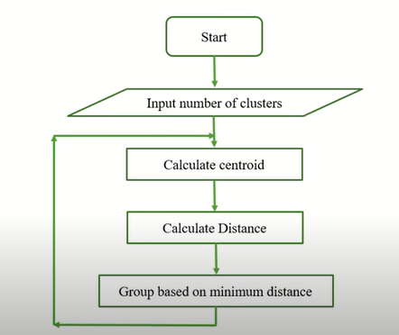
K-means clustering -Flowchart
<number>

Slide 14
K-Means algorithm-One Dimensional
K={2,3,4,10,11,12,20,25,30}
K=2
M1=4 M2=12
K1={2,3,4} K2={10,11,12,20,25,30}
M1=3 M2=18
K1={ 2,3,4,10} K2={11,12,20,25,30}
M1=4.75 =5 M2=19.6=20
K1={2,3,4,10,11,12} K2={20,25,30}
M1=7 M2=25
K1={2,3,4,10,11,12} K2={20,25,30}
M1=7 M2-25
<number>

Slide 15
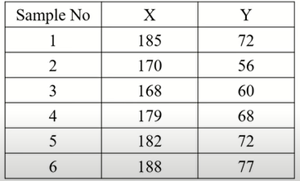
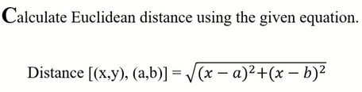
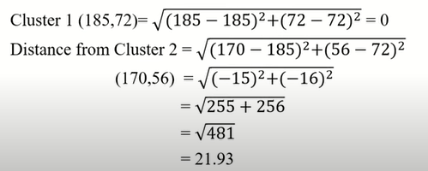
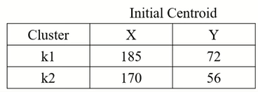
K-means Clustering two dimension
Example 1
<number>

Slide 16
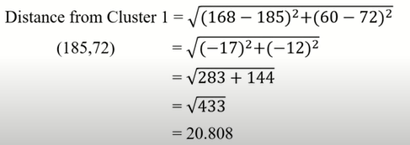
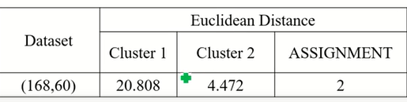
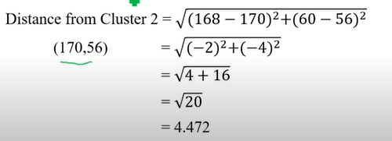
Contd..
<number>

Slide 17
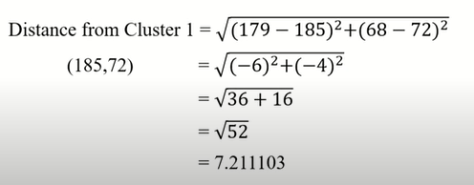
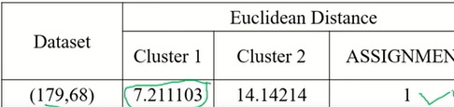
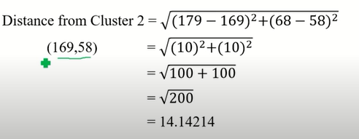
Contd..
<number>

Slide 18
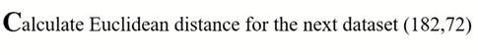
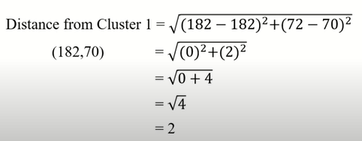
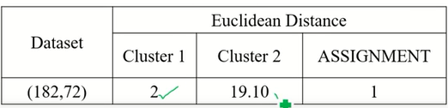
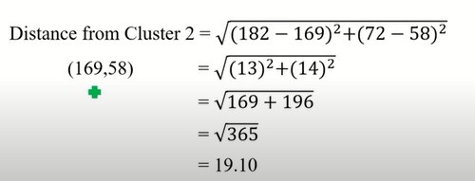
<number>

Slide 19
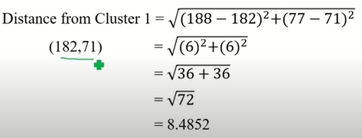
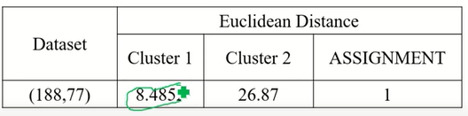
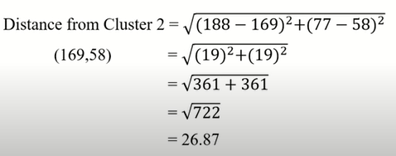
<number>

Slide 20
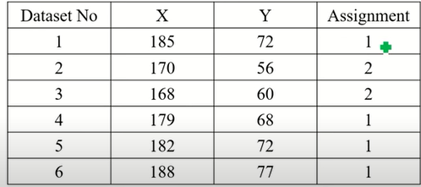
Final assignment
Updated centroid for cluster 1 ie. k1
(185+179+182+188)/4=184 (72+68+72+77)/4=72
For K2
(170+168)/2=169
(56+60)=58
<number>

Slide 21
Exercise 1
Height | Weight
185 | 72
170 | 56
168 | 60
179 | 68
182 | 72
188 | 77
180 | 71
180 | 70
183 | 84
180 | 88
180 | 67
177 | 76
<number>

Slide 22
Evaluating K-means Clusters
Most common measure is Sum of Squared Error (SSE)
For each point, the error is the distance to the nearest cluster
To get SSE, we square these errors and sum them.
x is a data point in cluster C_{i} and m_{i} is the representative point for cluster C_{i}
m_{i} corresponds to the center (mean) of the cluster
<number>

Slide 23
Importance of Choosing Initial Centroids
<number>

Slide 24
Importance of Choosing Initial Centroids
<number>

Slide 25
Importance of Choosing Initial Centroids …
<number>

Slide 26
Importance of Choosing Initial Centroids …
<number>

Slide 27
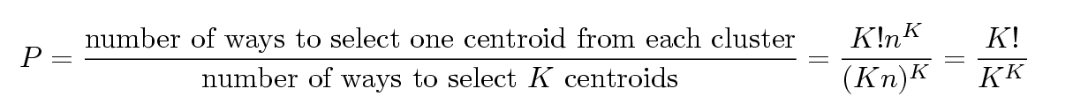
Problems with Selecting Initial Points
If there are K ‘real’ clusters then the chance of selecting one centroid from each cluster is small.
Chance is relatively small when K is large
If clusters are the same size, n, then
For example, if K = 10, then probability = 10!/10¹⁰ = 0.00036
Sometimes the initial centroids will readjust themselves in ‘right’ way, and sometimes they don’t
<number>

Slide 28
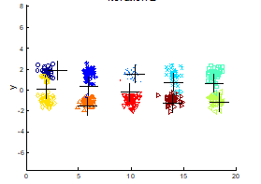
10 Clusters Example
<number>

Slide 29
10 Clusters Example
<number>

Slide 30
Solutions to Initial Centroids Problem
Multiple runs
Helps, but probability is not favorable
Sample and use hierarchical clustering to determine initial centroids
Select more than k initial centroids and then select among these initial centroids
Select most widely separated
Postprocessing
<number>

Slide 31
Pre-processing and Post-processing
Pre-processing
Normalize the data
Eliminate outliers
Post-processing
Eliminate small clusters that may represent outliers
Split ‘loose’ clusters, i.e., clusters with relatively high SSE
Merge clusters that are ‘close’ and that have relatively low SSE
<number>

Slide 32
Variations of the K-Means Method
Most of the variants of the k-means which differ in
Selection of the initial k means
Dissimilarity calculations
Strategies to calculate cluster means
Handling categorical data: k-modes
Replacing means of clusters with modes
Using new dissimilarity measures to deal with categorical objects
Using a frequency-based method to update modes of clusters
<number>
Notes:
<number>

Slide 34
Limitations of K-means
K-means has problems when clusters are of differing
Sizes
Densities
Non-globular shapes
K-means has problems when the data contains outliers.
<number>

Slide 35
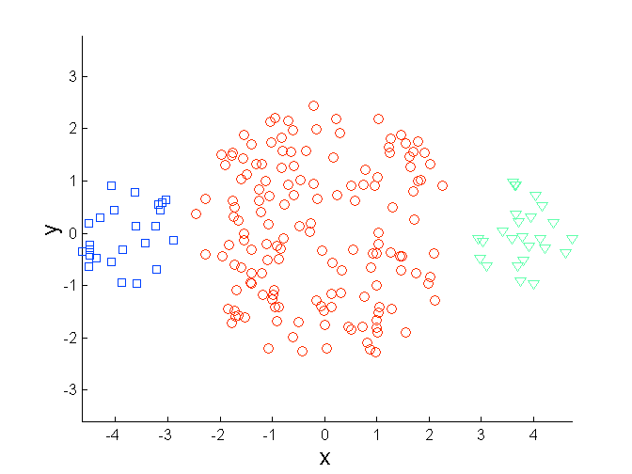
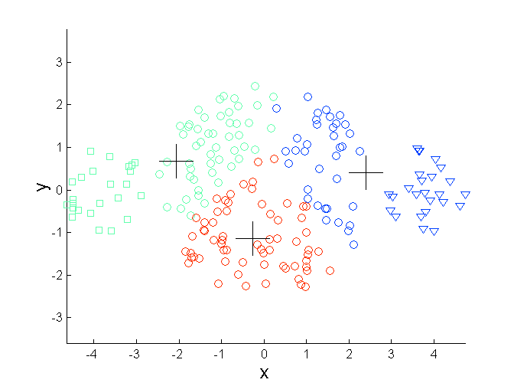
Limitations of K-means: Differing Sizes
Original Points
K-means (3 Clusters)
<number>

Slide 36
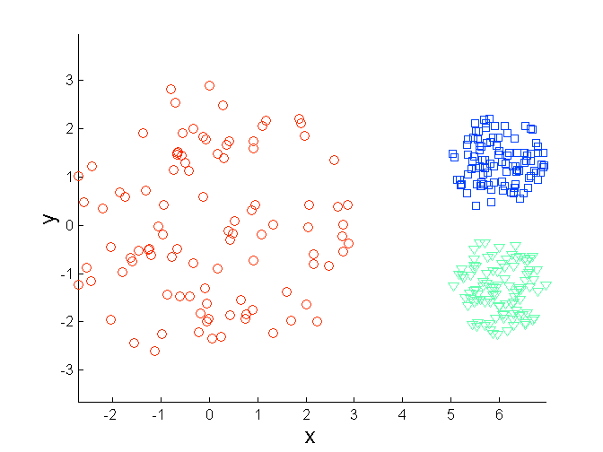
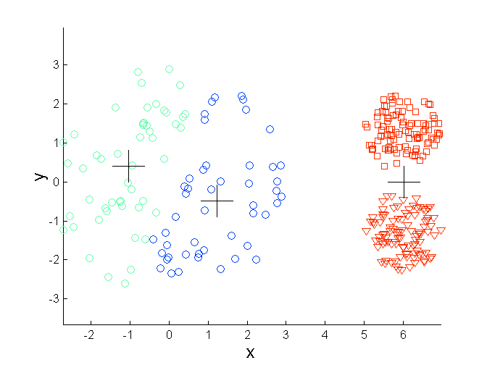
Limitations of K-means: Differing Density
Original Points
K-means (3 Clusters)
<number>

Slide 37
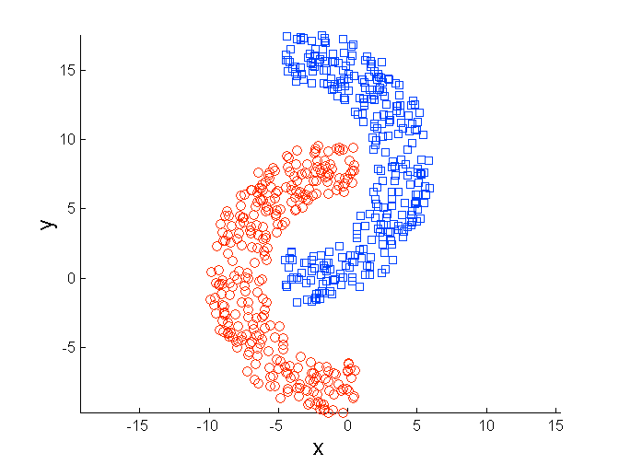
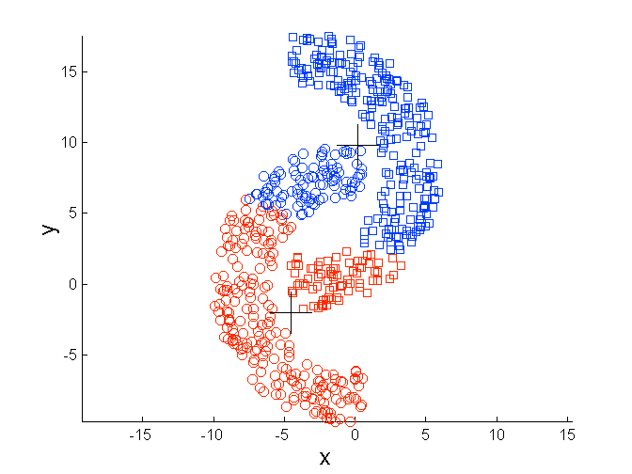
Limitations of K-means: Non-globular Shapes
Original Points
K-means (2 Clusters)
<number>

Slide 38
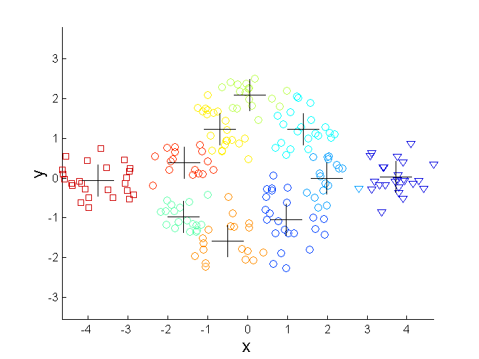
Overcoming K-means Limitations
Original Points K-means Clusters
<number>

Slide 39
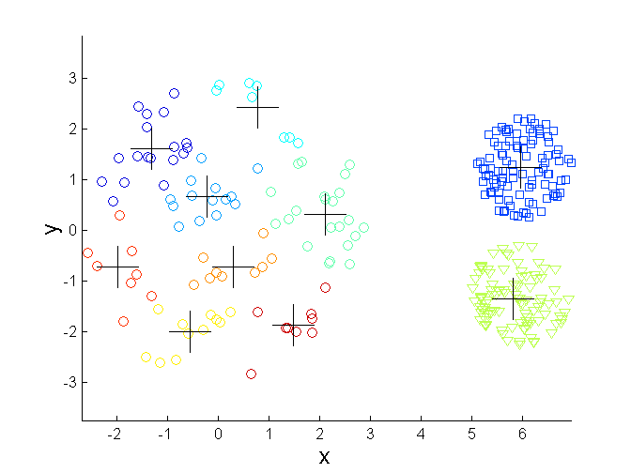
Overcoming K-means Limitations
Original Points K-means Clusters
<number>

Slide 40
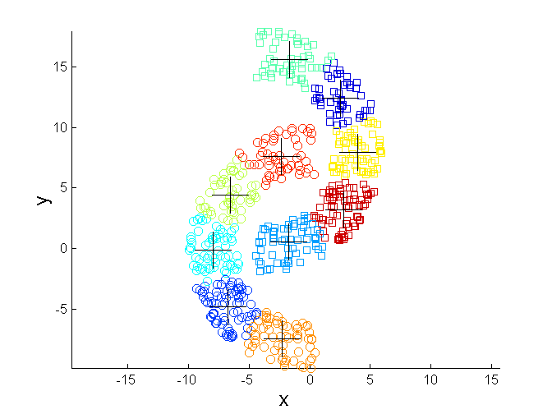
Overcoming K-means Limitations
Original Points K-means Clusters
<number>

Slide 41
Comments on the K-Means Method
Strength: Efficient: O(tkn), where n is # objects, k is # clusters, and t is # iterations. Normally, k, t << n.
Comparing: PAM: O(k(n-k)² ), CLARA: O(ks² + k(n-k))
Comment: Often terminates at a local optimal.
Weakness
Applicable only to objects in a continuous n-dimensional space
Using the k-modes method for categorical data
In comparison, k-medoids can be applied to a wide range of data
Need to specify k, the number of clusters, in advance
Sensitive to noisy data and outliers
Not suitable to discover clusters with non-convex shapes
<number>
Notes:
<number>

Slide 42
The K-Medoid Clustering Method
K-Medoids Clustering: Find representative objects (medoids) in clusters
PAM (Partitioning Around Medoids)
Starts from an initial set of medoids and iteratively replaces one of the medoids by one of the non-medoids if it improves the total distance of the resulting clustering
PAM works effectively for small data sets, but does not scale well for large data sets (due to the computational complexity)
Efficiency improvement on PAM
CLARA : PAM on samples
CLARANS : Randomized re-sampling
<number>
Notes:
<number>

Slide 43
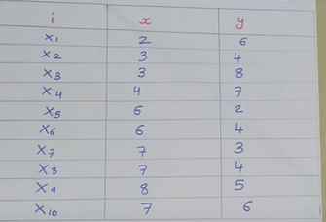
Example
1.Choose 2 medoids(3,4)and (7,4)
2.Use Manhattan distance
<number>

Slide 44
i | x | y | c1 | Distance/cost | c
1 | 2 | 6 | 3 4 | (2-3)+(6-4) | 3
3 | 3 | 8 | 3 4 | 0+4 | 4
4 | 4 | 7 | 3 4 | 1+3 | 4
5 | 6 | 2 | 3 4 | 3+2 | 5
6 | 6 | 4 | 3 4 | 3+0 | 3
7 | 7 | 3 | 3 4 | 4+1 | 5
9 | 8 | 5 | 3 4 | 5+1 | 6
10 | 7 | 6 | 3 4 | 4+2 | 6
i | x | y | c1 | c
1 | 2 | 6 | 7 4 | 7
3 | 3 | 8 | 7 4 | 8
4 | 4 | 7 | 7 4 | 6
5 | 6 | 2 | 7 4 | 3
6 | 6 | 4 | 7 4 | 1
7 | 7 | 3 | 7 4 | 1
9 | 8 | 5 | 7 4 | 2
10 | 7 | 6 | 7 4 | 2
i | x | y | c1 | c2
1 | 2 | 6 | 3 | 7
3 | 3 | 8 | 4 | 8
4 | 4 | 7 | 4 | 6
5 | 6 | 2 | 5 | 3
6 | 6 | 4 | 3 | 1
7 | 7 | 3 | 5 | 1
9 | 8 | 5 | 6 | 2
10 | 7 | 6 | 6 | 2
Cluster1{(2,6).(3,8),(4,7),(3,4)
Cluster2:{(7,4)(6,2),(6,4),(7,3),(8,5),(7,6)}
Calculate the total cost
{cost (3,4),(2,6)),Cost ((3,4),(3,8)),Cost (3,4),(4,7),cost( (7,4)(7,6)),cost((7,4)(6,2)),cost((7,4)(6,4))
Cost((7,4)(7,3)),cost((7,4) (8,5))
=(3+4+4)+(3+1+1+2+2)=20
<number>

Slide 45
Select one of non mediod (7,3)
i | x | y | c1 | Distance/cost | c
1 | 2 | 6 | 3 4 | (2-3)+(6-4) | 3
3 | 3 | 8 | 3 4 | 0+4 | 4
4 | 4 | 7 | 3 4 | 1+3 | 4
5 | 6 | 2 | 3 4 | 3+2 | 5
6 | 6 | 4 | 3 4 | 3+0 | 3
8 | 7 | 4 | 3 4 | 4+0 | 4
9 | 8 | 5 | 3 4 | 5+1 | 6
10 | 7 | 6 | 3 4 | 4+2 | 6
i | x | y | c1 | Distance/cost
1 | 2 | 6 | 7 3 | 8
3 | 3 | 8 | 7 3 | 9
4 | 4 | 7 | 7 3 | 7
5 | 6 | 2 | 7 3 | 2
6 | 6 | 4 | 7 3 | 2
8 | 7 | 4 | 7 3 | 1
9 | 8 | 5 | 7 3 | 3
10 | 7 | 6 | 7 3 | 3
i | x | y | c
1 | 2 | 6 | 3 | 8
3 | 3 | 8 | 4 | 9
4 | 4 | 7 | 4 | 7
5 | 6 | 2 | 5 | 2
6 | 6 | 4 | 3 | 2
8 | 7 | 4 | 4 | 1
9 | 8 | 5 | 6 | 3
10 | 7 | 6 | 6 | 3
Cluster1 {(3,4),(2,6)(3,8),(4,7)}
Cluster2{{7,3),(6,2),(5,4),(7,4),(8,5)(7,6)}
Cost =(3+4+4)+(2+2+1+3+3)
22
First cluster has less cost value so we need to select first cluster
<number>

Slide 46
Hierarchical clustering
<number>

Slide 47
Hierarchical Clustering
Produces a set of nested clusters organized as a hierarchical tree
Example
animal
vertebrate
invertebrate
fish reptile amphib. mammal worm insect crustacean
<number>

Slide 48
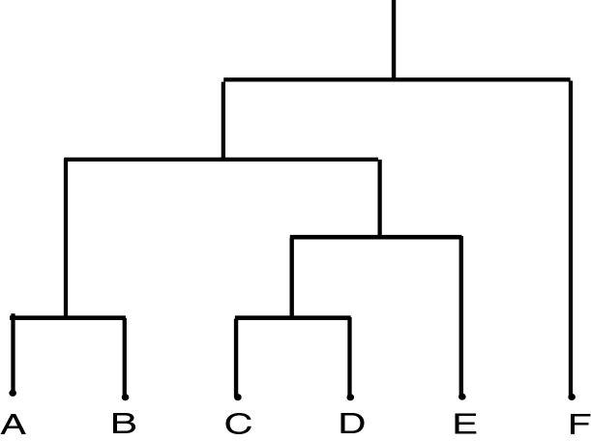
Dendrogram
Dendrogram: a tree data structure which illustrates hierarchical clustering techniques.
Each level shows clusters for that level.
Leaf – individual clusters Root – one cluster
A cluster at level i is the union of its children clusters at level i+1
<number>

Slide 49
Strengths of Hierarchical Clustering
Do not have to assume any particular number of clusters
Any desired number of clusters can be obtained by ‘cutting’ the dendogram at the proper level
<number>

Slide 50
Two main types of hierarchical clustering
Agglomerative:
Start with the points as individual clusters
At each step, merge the closest pair of clusters until only one cluster (or k clusters) left.
Divisive:
Start with one, all-inclusive cluster
At each step, split a cluster until each cluster contains a point (or there are k clusters)
<number>

Slide 51
Hierarchical Clustering
Use distance matrix as clustering criteria. This method does not require the number of clusters k as an input, but needs a termination condition
Step 0
Step 1
Step 2
Step 3
Step 4
agglomerative
a b c d e
a b
a b c d e c d e
d e
divisive
Step 4
Step 3
Step 2
Step 1
Step 0
<number>

Slide 52
Agglomerative Clustering Algorithm
More popular hierarchical clustering technique
Basic algorithm is straightforward
Compute the proximity matrix
Let each data point be a cluster
Repeat
Merge the two closest clusters
Update the proximity matrix
Until only a single cluster remains
Key operation is the computation of the proximity of two clusters
Different approaches to defining the distance between clusters distinguish the different algorithms
<number>

Slide 53
Starting Situation
Start with clusters of individual points and a proximity matrix
p1
p2
p3
p4
p5
. . .
p1
p2
p3
p4
p5
.
.
.
Proximity Matrix
<number>

Slide 54
Intermediate Situation
After some merging steps, we have some clusters
C1
C2
C3
C4
C5
C1
C2
C3
C3
C4
C4
C5
Proximity Matrix
C1
C2
C5
<number>

Slide 55
Intermediate Situation
We want to merge the two closest clusters (C2 and C5) and update the proximity matrix.
C1
C2
C3
C4
C5
C1
C2
C3
C3
C4
C4
C5
Proximity Matrix
C1
C2
C5
<number>

Slide 56
Example
<number>

Slide 57
Agglomerative Clustering Example
Item | E | A | C | B | D
E | 0 | 1 | 2 | 2 | 3
A | 1 | 0 | 2 | 5 | 3
C | 2 | 2 | 0 | 1 | 6
B | 2 | 5 | 1 | 0 | 3
D | 3 | 3 | 6 | 3 | 0
From this you can ignore upper triangular data is it will be identical
Item | E | A | C | B | D
E | 0
A | 1 | 0
C | 2 | 2 | 0
B | 2 | 5 | 1 | 0
D | 3 | 3 | 6 | 3 | 0
<number>

Slide 58
Agglomerative Clustering Example
Item | E | A | C | B | D
E | 0
A | 1 | 0
C | 2 | 2 | 0
B | 2 | 5 | 1 | 0
D | 3 | 3 | 6 | 3 | 0
Step1: Find out the smallest distance except 0, here it is 1 between E and A
So, dendrogram will be
1
E
A
Step2: Merge cell E and A, to find the distance between EA and C, We need to find
Min dist [ {E,A}, C] Min dist [ (E,C), (A,C)] Min dist [2,2] = 2
Likewise you need to find it for EA,B and EA,D
Item | EA | C | B | D
EA | 0
C | 2 | 0
B | 2 | 1 | 0
D | 3 | 6 | 3 | 0
<number>

Slide 59
Agglomerative Clustering Example
Item | EA | C | B | D
EA | 0
C | 2 | 0
B | 2 | 1 | 0
D | 3 | 6 | 3 | 0
Again Find out the smallest distance except 0, here it is 1 between B and C
So, dendrogram will be
1
E
A B
C
Merge cell B and C, to find the distance between EA and BC, We need to find
Min dist [ {E,A}, {B,C}]
Min dist [ (E,B), (E,C), (A,B), (A,C)]
Min dist [2,2,2,5] = 2
Likewise you need to find it for BC and D
Item | EA | BC | D
EA | 0
BC | 2 | 0
D | 3 | 3 | 0
<number>

Slide 60
Agglomerative Clustering Example
Item | EA | BC | D
EA | 0
BC | 2 | 0
D | 3 | 3 | 0
Again Find out the smallest distance except 0, here it is 2 between EA, and BC
So, dendrogram will be
2
1
E
A B
C
Merge cell EA and BC, to find the distance between EABC and D, We need to find
Min dist [ {E,A,B,C}, {D}]
Min dist [ (E,D), (A,D), (B,D), (C,D)]
Min dist [3,3,6,3] = 3
Item | EABC | D
EABC | 0
D | 3 | 0
<number>

Slide 61
Agglomerative Clustering Example
Item | EABC | D
EABC | 0
D | 3 | 0
Again smallest distance is 3
So, dendrogram will be
3
2
1
E
AB
C
D
Merge cell EABC and D
Item | EABCD
EABCD | 0
<number>

Slide 62
How to Define Inter-Cluster Similarity
p1
p2
p3
p4
p5
. . .
Similarity?
p1
p2
p3
p4
MIN
MAX
Group Average
Distance Between Centroids
Other methods driven by an objective function
p5
.
.
.
Proximity Matrix
<number>

Slide 63
How to Define Inter-Cluster Similarity
p1
p2
p3
p4
p5
. . .
p1
p2
p3
p4
p5
MIN
MAX
Group Average
Distance Between Centroids
Other methods driven by an objective function
.
.
.
Proximity Matrix
<number>

Slide 64
How to Define Inter-Cluster Similarity
p1
p2
p3
p4
p5
. . .
p1
p2
p3
p4
p5
MIN
MAX
Group Average
Distance Between Centroids
Other methods driven by an objective function
.
.
.
Proximity Matrix
<number>

Slide 65
How to Define Inter-Cluster Similarity
p1
p2
p3
p4
p5
. . .
p1
p2
p3
p4
p5
MIN
MAX
Group Average
Distance Between Centroids
Other methods driven by an objective function
.
.
.
Proximity Matrix
<number>

Slide 66
How to Define Inter-Cluster Similarity
p1
p2
p3
p4
p5
. . .
p1
×
×
p2
p3
p4
p5
MIN
MAX
Group Average
Distance Between Centroids
Other methods driven by an objective function
.
.
.
Proximity Matrix
<number>

Slide 67
Hierarchical Algorithms
Single Link
Complete Link
Average Link
<number>

Slide 68
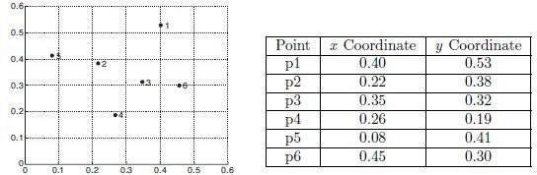
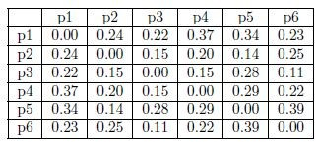
Sample dataset
<number>

Slide 69
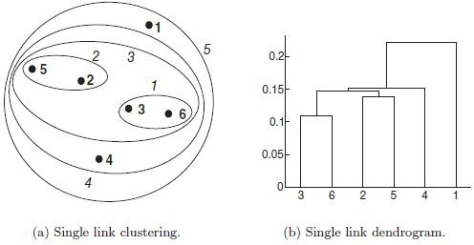
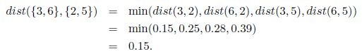
Single Link
<number>

Slide 70
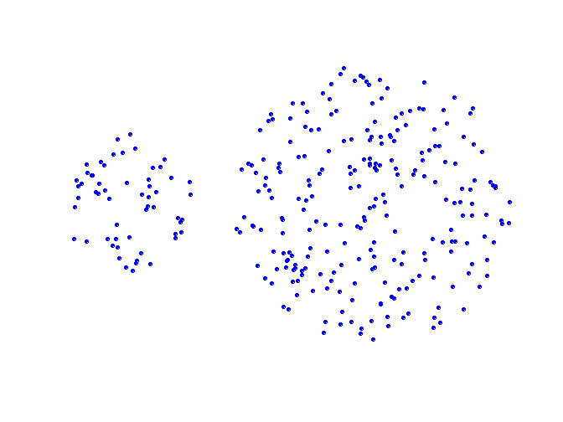
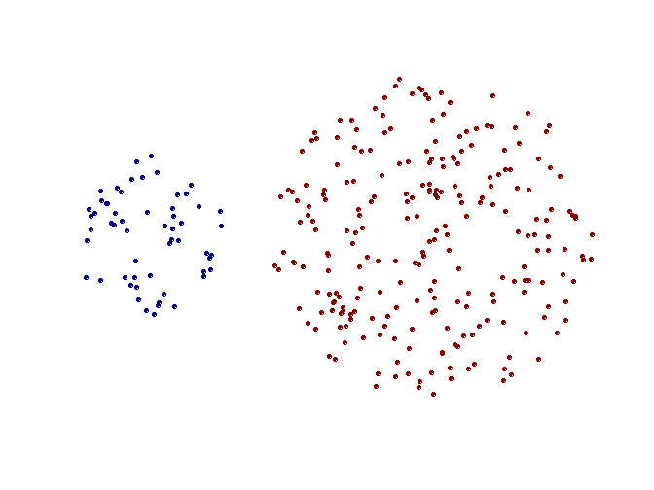
Strength of MIN
Original Points
Two Clusters
Can handle non-elliptical shapes
<number>

Slide 71
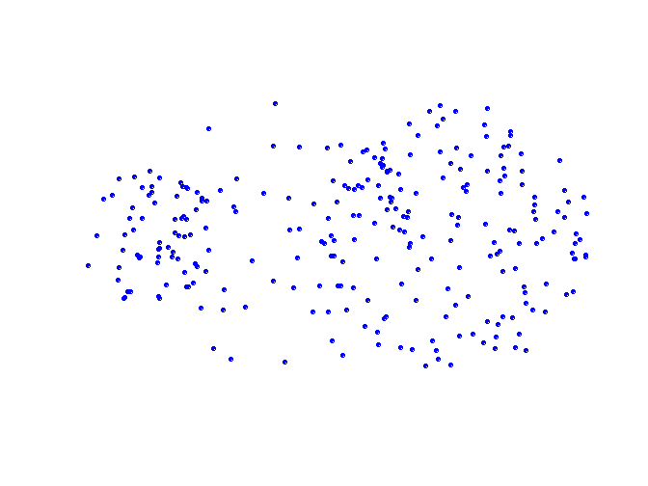
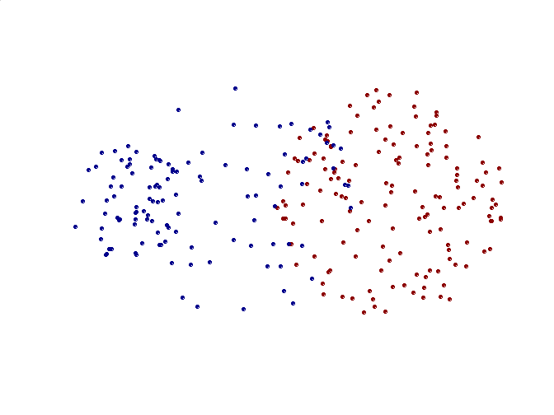
Limitations of MIN
Original Points
Two Clusters
Sensitive to noise and outliers
<number>

Slide 72

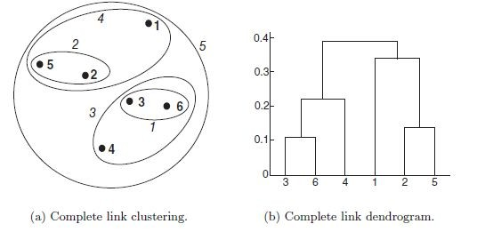
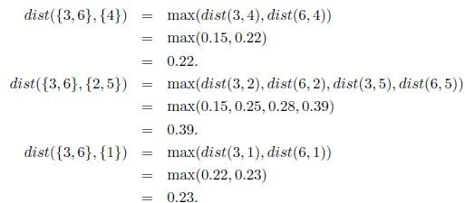
Complete Link or MAX
<number>

Slide 73
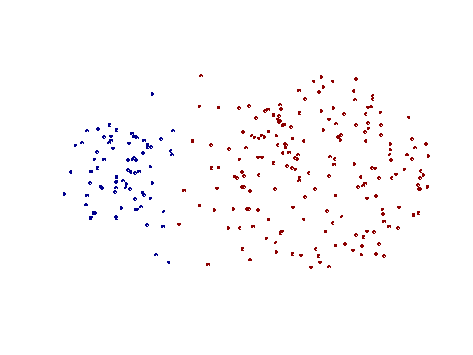
Strength of MAX
Original Points
Two Clusters
Less susceptible to noise and outliers
<number>

Slide 74
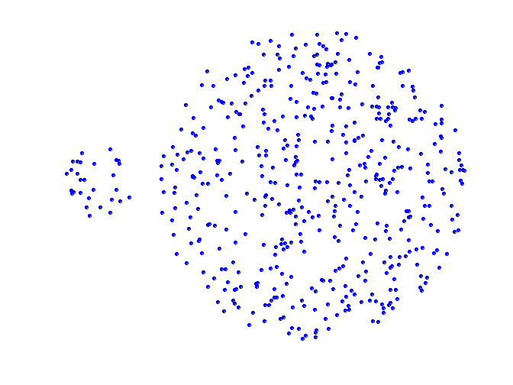
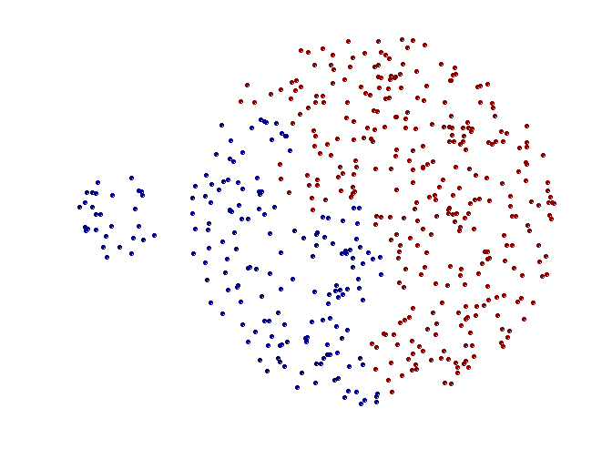
Limitations of MAX
Original Points
Two Clusters
Tends to break large clusters
<number>

Slide 75
Hierarchical Clustering: Group Average
Proximity of two clusters is the average of pairwise proximity between points in the two clusters.
5
4
1
2
5
2
3
6
1
4
3
Nested Clusters
Dendrogram
<number>

Slide 76
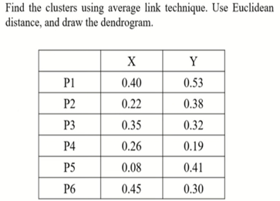
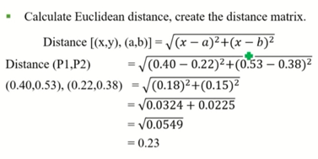
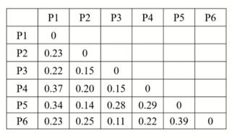
<number>

Slide 77
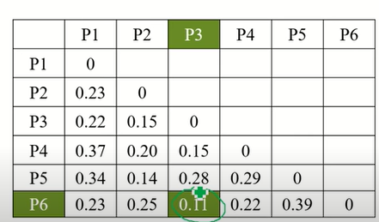
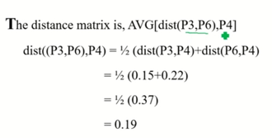





<number>

Slide 78






<number>

Slide 79





<number>

Slide 80



<number>

Slide 81

 | p1p2p3p4p5p6
P1 p2p3p4p5p6 | 0
<number>

Slide 82
Hierarchical Clustering: Comparison
5
1
4
1
3
2
5
5
5
2
1
MIN
2
MAX
2
3
6
3
3
6
1
4
4
4
5
4
1
2
5
2
Group Average
3
6
1
4
3
<number>

Slide 83
Divisive Hierarchical Clustering algorithm
<number>

Slide 84

MST: Divisive Hierarchical Clustering
Build Minimum spanning tree
<number>

Slide 85

MST: Divisive Hierarchical Clustering
Use MST for constructing hierarchy of clusters
<number>

Slide 86

Example
 | 1 | 2 | 3 | 4 | 5
1 | 0
2 | 9 | 0
3 | 3 | 7 | 0
4 | 6 | 5 | 9 | 0
5 | 11 | 10 | 2 | 8 | 0
Edge | cost
3-5 | 2
1-3 | 3
2-4 | 5
1-4 | 6
2-3 | 7
4-5 | 8
1-2 | 9
3-4 | 9
2-5 | 10
5-1 | 11
Edge | Cost
3-5 | 2
1-3 | 3
2-4 | 5
1-4 | 6
<number>

Slide 87




Contd..
<number>

Slide 88
Hierarchical Clustering: Time and Space requirements
O(N²) space
O(N³) time in many cases
<number>

Slide 89
Hierarchical Clustering: Problems and Limitations
Once a decision is made to combine two clusters, it cannot be undone
No objective function is directly minimized
Different schemes have problems with one or more of the following:
Sensitivity to noise and outliers
Difficulty handling different sized clusters and convex shapes
Breaking large clusters
<number>

Slide 90
More Hierarchical methods
<number>

Slide 91
Extensions to Hierarchical Clustering
Major weakness of agglomerative clustering methods
Can never undo what was done previously
Do not scale well: time complexity of at least O(n²), where n is the number of total objects
Integration of hierarchical & distance-based clustering
BIRCH : uses CF-tree and incrementally adjusts the quality of sub-clusters
<number>
Notes:
<number>

Slide 92
BIRCH algorithm
Balanced Iterative Reducing and Clustering Using Hierarchies
BIRCH only needs to scan the data set in a single pass to perform clustering.
Suitable for the case where the amount of data is large
<number>
Notes:
<number>

Slide 93






Centroid, Radius and Diameter of a Cluster
$C_{m}=\frac{Σ_{i=1}^{N}\left(x_{i}\right)}{}$
<number>
<number>
Notes:
<number>

Slide 94

Clustering Feature Vector in BIRCH
<number>

Slide 95

CF-Tree in BIRCH
A CF tree is a height-balanced tree that stores the clustering features for a hierarchical clustering
A nonleaf node in a tree has descendants or “children”
The nonleaf nodes store sums of the CFs of their children
A CF tree has two parameters
Branching factor: max # of children
Threshold: max diameter of sub-clusters stored at the leaf nodes
<number>
Notes:
<number>

Slide 96
The CF Tree Structure -Example
Root
B = 7
L = 6
CF₁
CF₂
CF₃
CF₆
child₁
child₂
child₃
child₆
Non-leaf node
CF₁
CF₂
CF₃
CF₅
child₁
child₂
child₃
child₅
Leaf node
Leaf node
prev
CF₁
CF₂
CF₆
next
prev
CF₁
CF₂
CF₄
next
Each non-leaf node contains at most B entries. A leaf node contains at most L entries
<number>
Notes:
<number>

Slide 97




Example-Generation of Clustering Feature Tree (CF Tree)
<number>

Slide 98



Example
<number>

Slide 99
BIRCH Steps
Find the leaf node closest to the new sample and the closest CF node in the leaf node from the root node
After the new sample is added, if the radius of the hyper-sphere corresponding to this CF node still satisfies the threshold T, then all the CF triplets on the path are updated, and the insertion ends. Otherwise, go to 3.
If the number of CF nodes of the current leaf node is less than the threshold L, create a new CF node, put in a new sample and the new CF node into this leaf node, update all CF triplets on the path, and insertion Ends. Otherwise, go to 4
Divide the current leaf node into two new leaf nodes, select the two CF tuples with the farthest hyper-sphere among all CF tuples in the old leaf node, and distribute as the first CF node of the two new leaf nodes. Put other tuples and new sample tuples into corresponding leaf nodes according to the principle of distance.
In turn, check whether the parent node is also to be split. If it needs to be split in the same way as the leaf node.
<number>

Slide 100
The Birch Algorithm
Cluster Diameter
In first phase, For each point in the input
Find closest leaf entry
Add point to leaf entry and update CF
If entry diameter > max_diameter, then split leaf, and possibly parents
Algorithm is O(n)
Concerns
Sensitive to insertion order of data points
Since we fix the size of leaf nodes, so clusters may not be so natural
Clusters tend to be spherical given the radius and diameter measures
<number>
Notes:
<number>

Slide 101

Example
<number>

Slide 102

<number>

Slide 103

<number>

Slide 104

<number>

Slide 105

<number>

Slide 106
<number>

Slide 107
Thank you ☺
Q&A
Suggestions / Feedback
<number>
BITS Pilani, Pilani Campus

